Slide 1
HTML(Hypertext Markup Language)

Slide 2
What is HTML?
HTML stands for Hyper Text Markup Language
HTML is the standard markup language for creating Web pages
HTML describes the structure of a Web page
HTML consists of a series of elements
HTML elements tell the browser how to display the content
HTML elements label pieces of content such as "this is a heading", "this is a paragraph", "this is a link", etc.

Slide 3
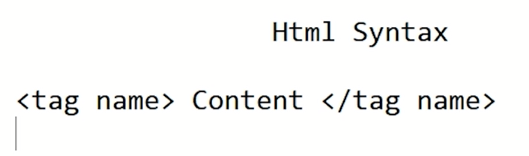
Html syntax:
Syntax means the formation of a sentence. It is the way to write the language.

Slide 4
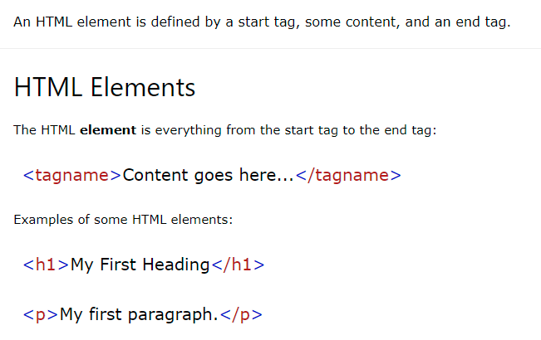
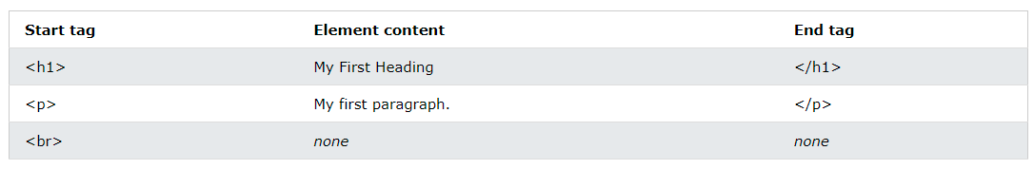
Note: Some HTML elements have no content (like the <br> element). These elements are called empty elements. Empty elements do not have an end tag!
Self closing tag:
<br>: This tag use for line break. It has no opening or close tag. It has only one tag.
<img>: this tag use for image.
It is also a self closing tag.

Slide 5
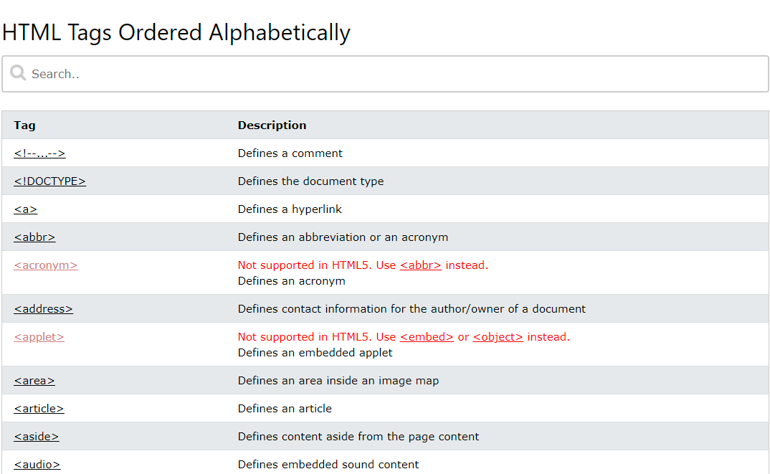

Slide 6
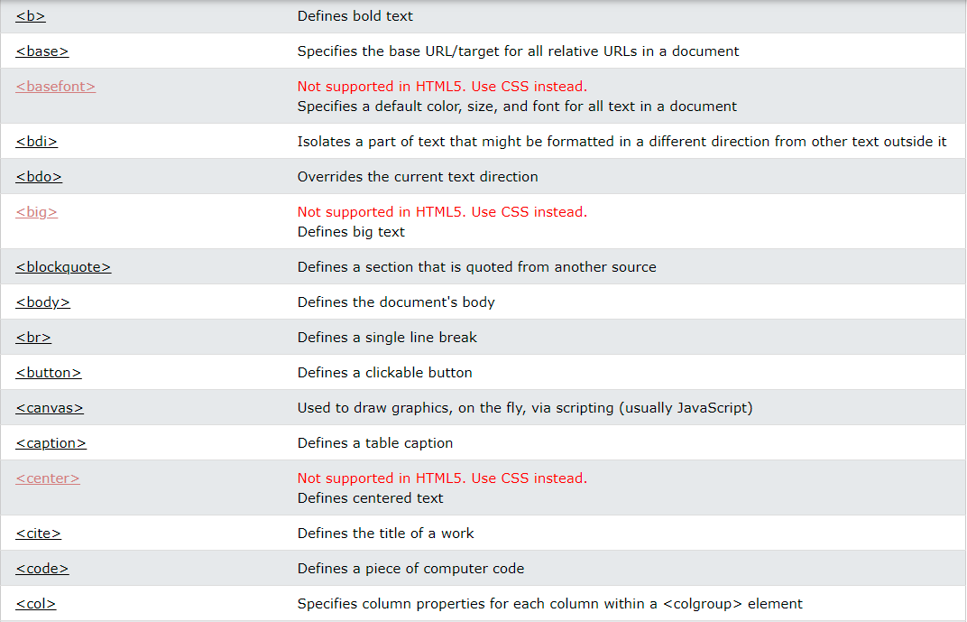

Slide 7
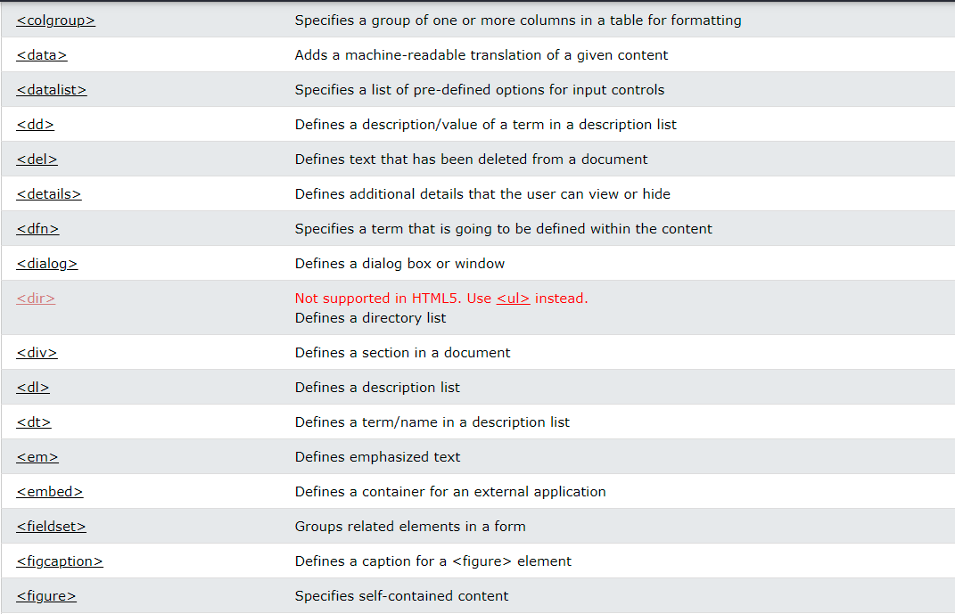

Slide 8
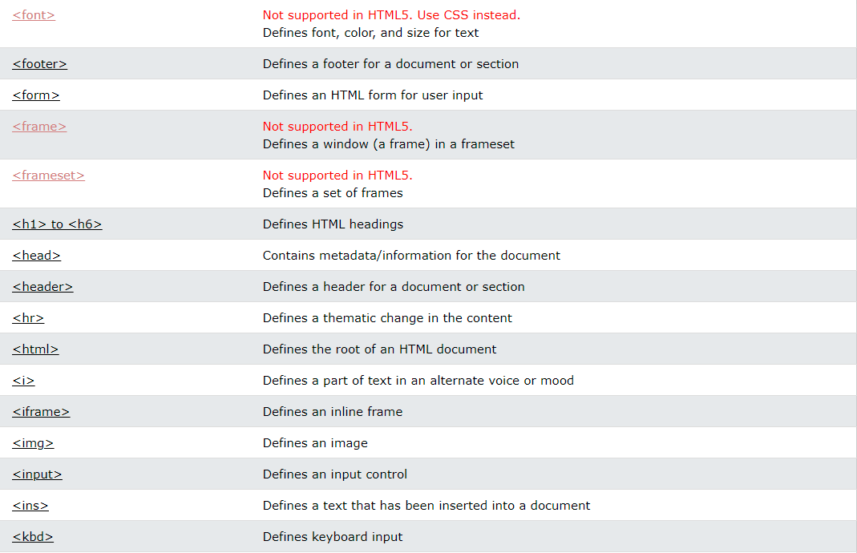

Slide 9
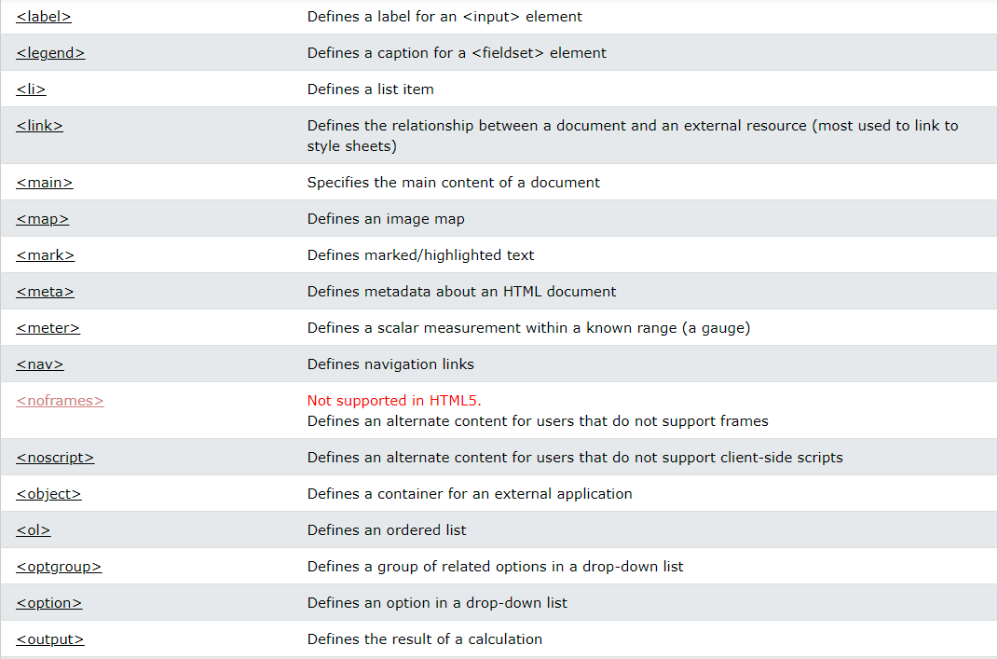

Slide 10
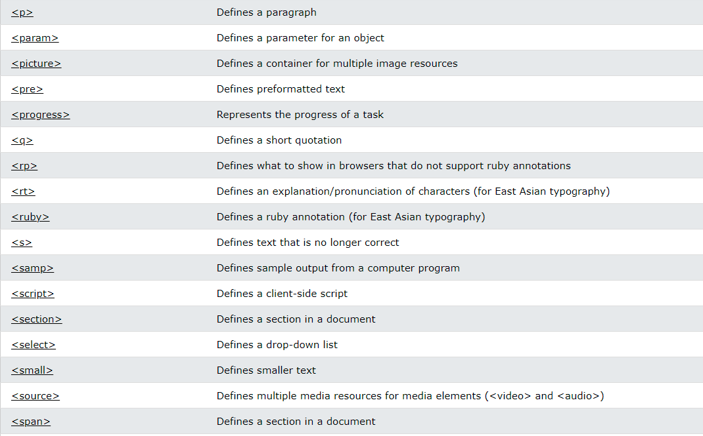

Slide 11
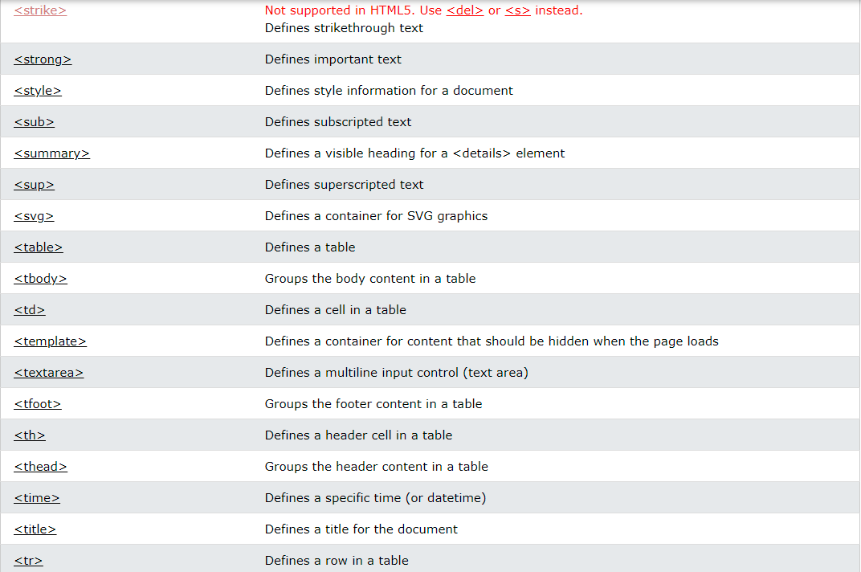

Slide 12
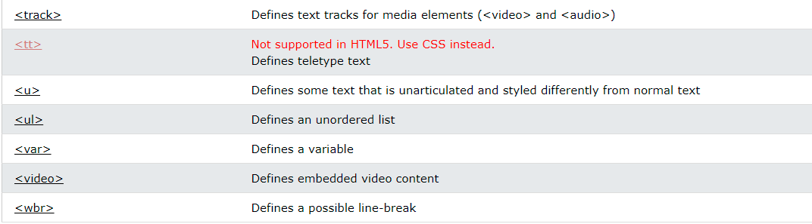

Slide 13
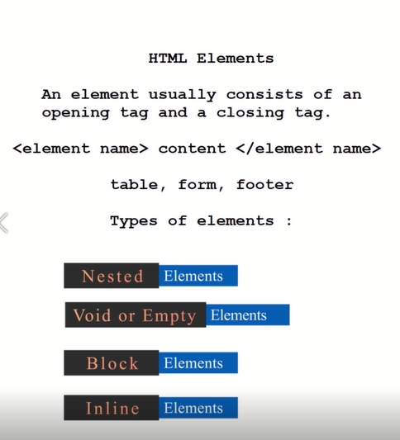

Slide 14
Nested HTML Elements
HTML elements can be nested (this means that elements can contain other elements).
All HTML documents consist of nested HTML elements.
The following example contains four HTML elements (<html>, <body>, <h1> and <p>)
The <html> element is the root element and it defines the whole HTML document.
It has a start tag <html> and an end tag </html>.
Then, inside the <html> element there is a <body> element
The <body> element defines the document's body.
It has a start tag <body> and an end tag </body>.
Then, inside the <body> element there are two other elements: <h1> and <p>
The <h1> element defines a heading.
It has a start tag <h1> and an end tag </h1>:
The <p> element defines a paragraph.
It has a start tag <p> and an end tag </p>:

Slide 15
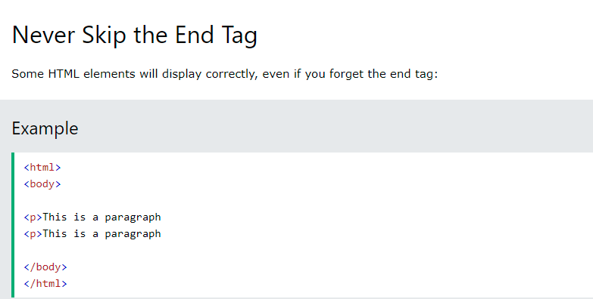
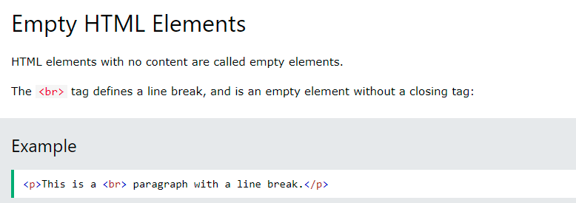

Slide 16
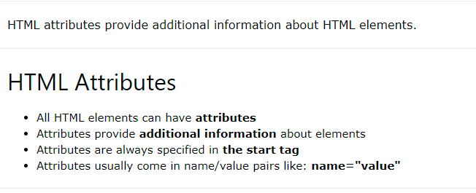

Slide 17
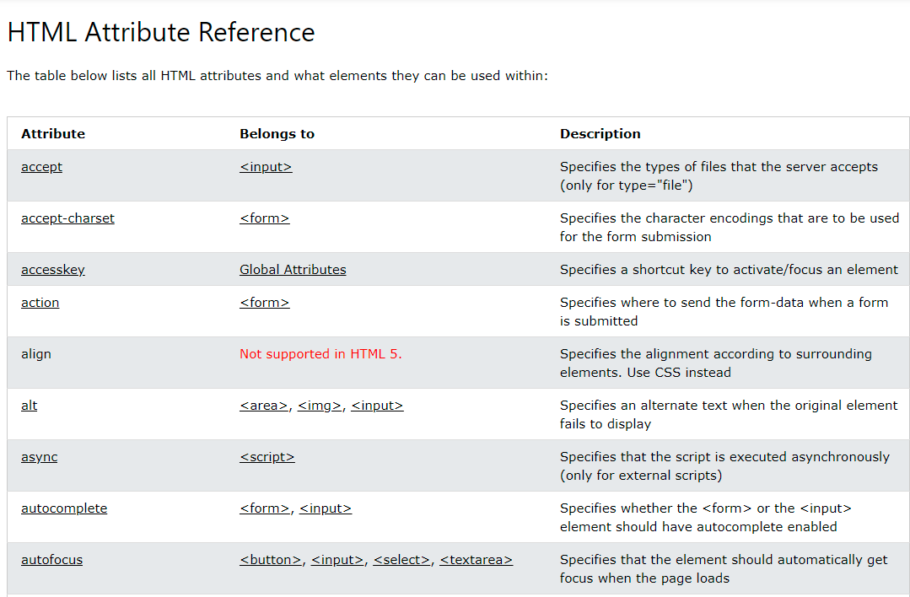

Slide 18
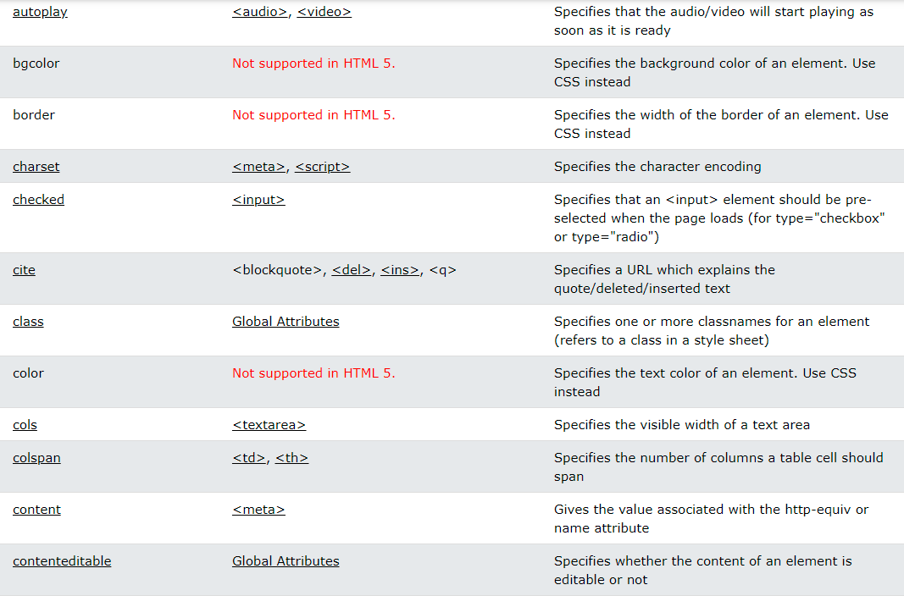

Slide 19
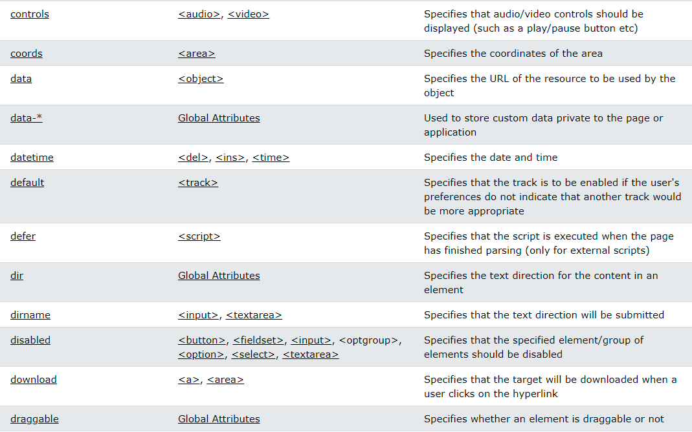

Slide 20
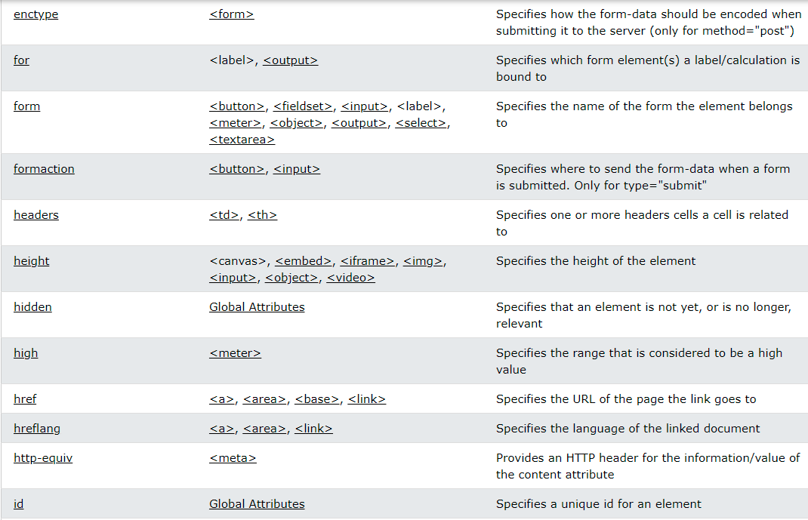

Slide 21
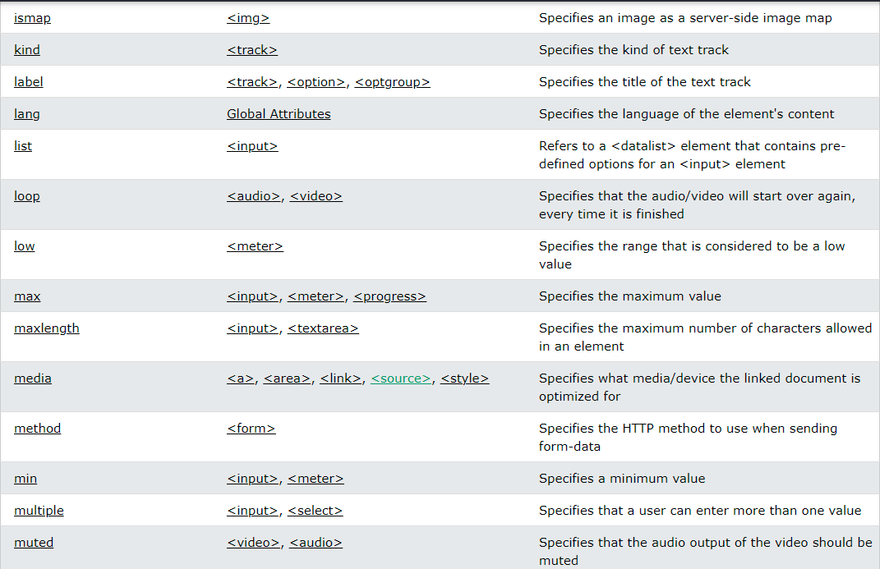

Slide 22
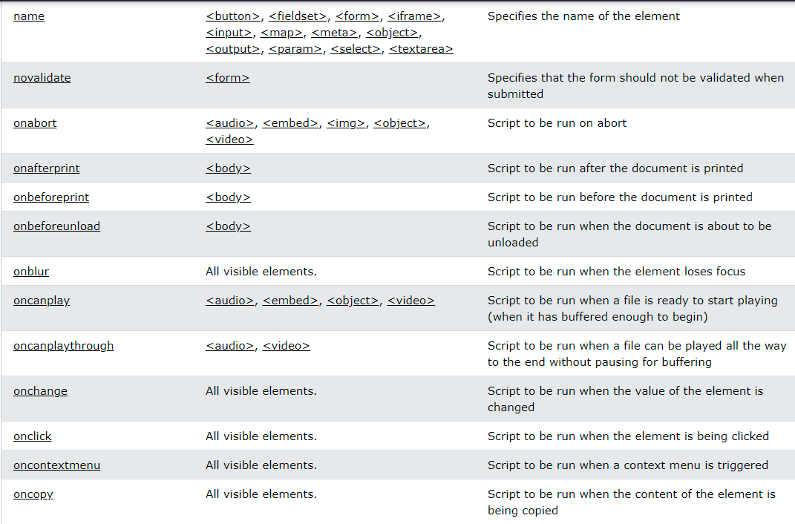

Slide 23
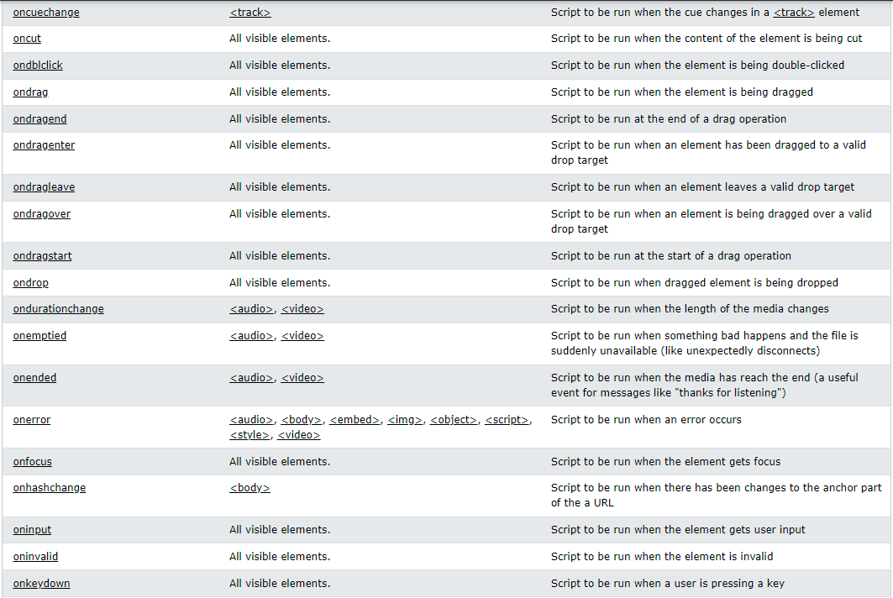

Slide 24
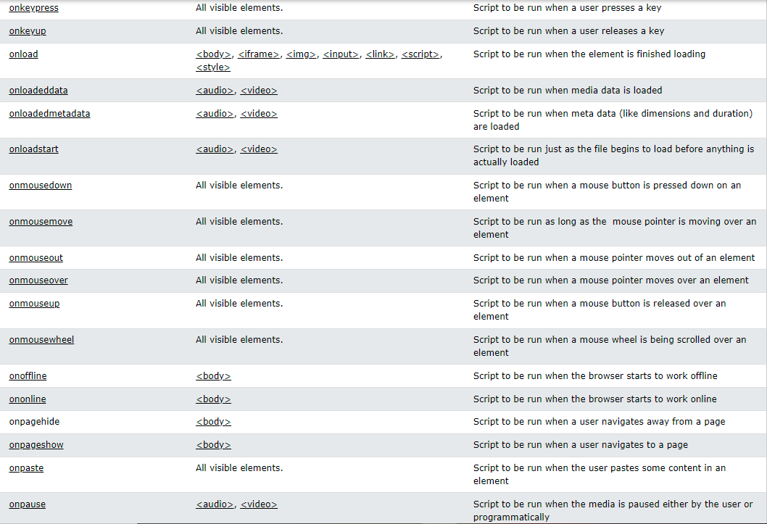

Slide 25
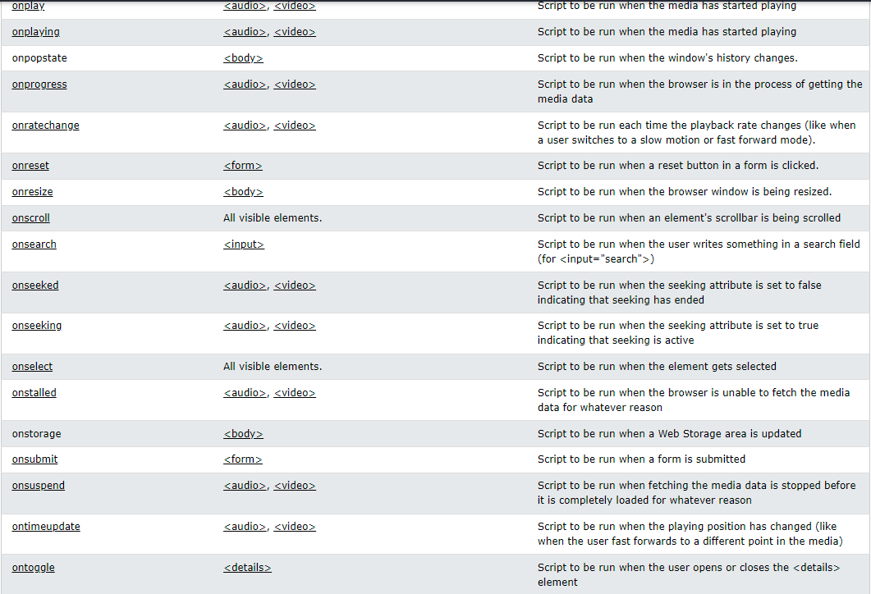

Slide 26
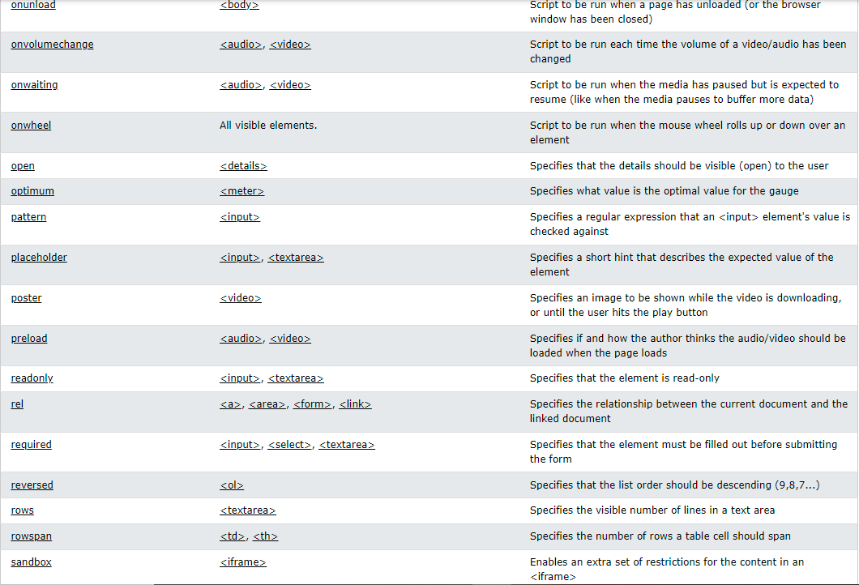

Slide 27
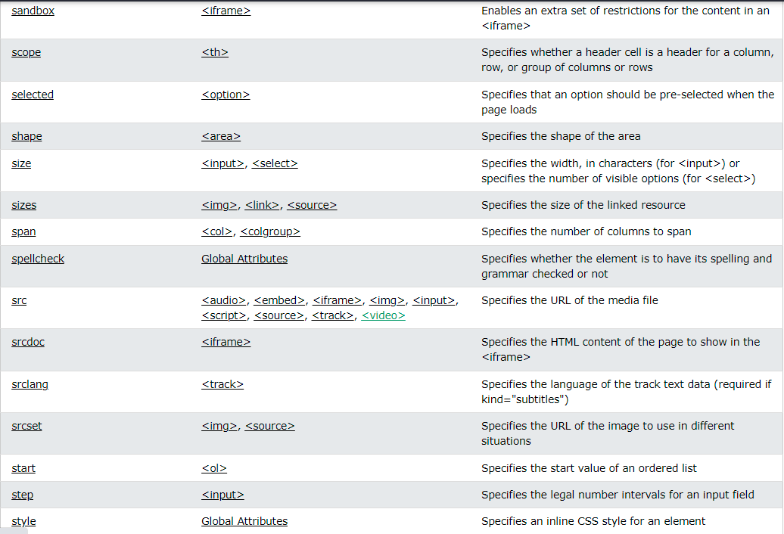

Slide 28
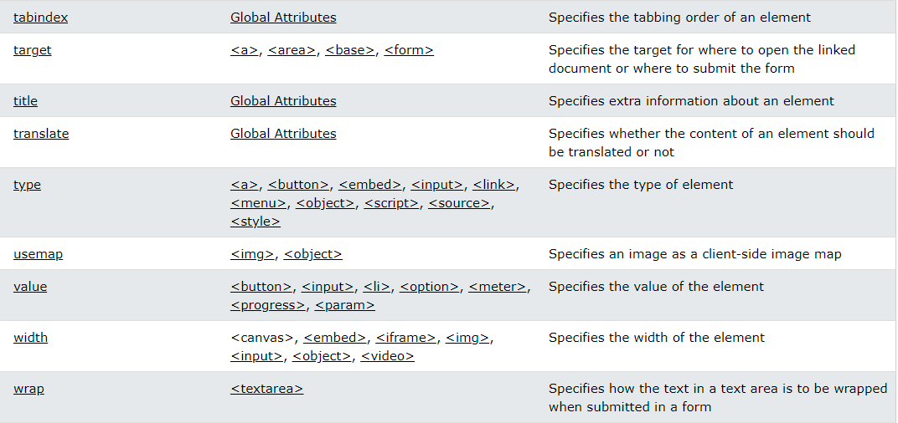

Slide 29
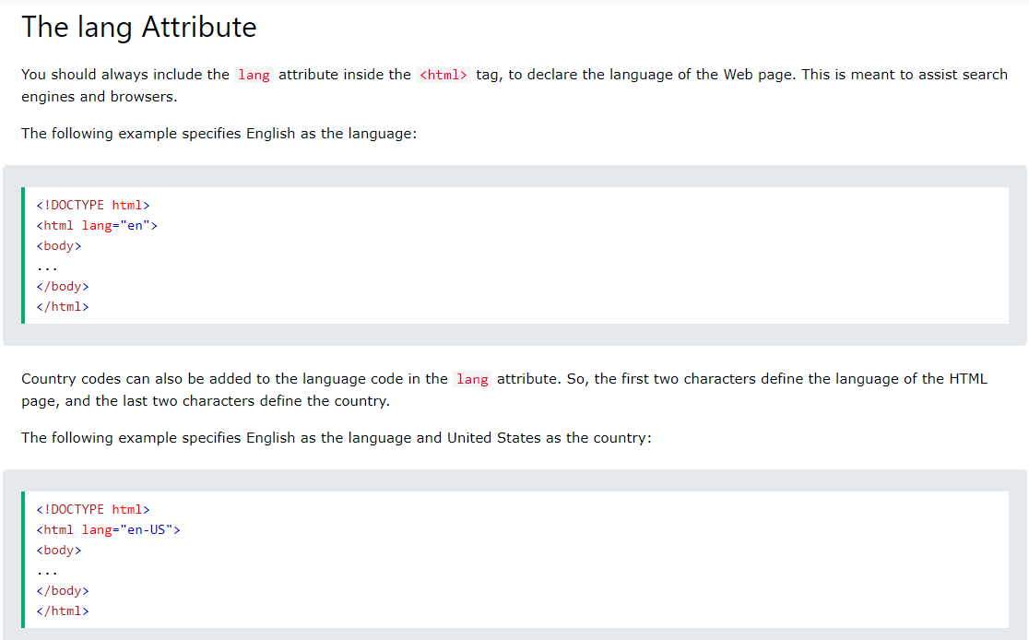

Slide 30
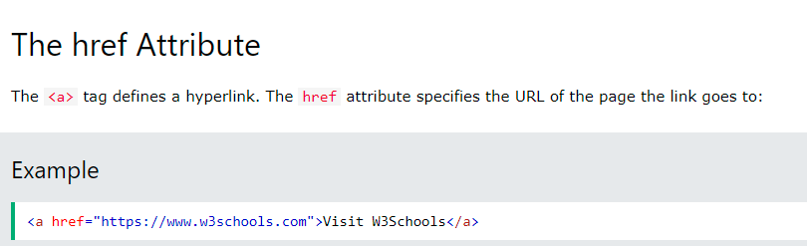
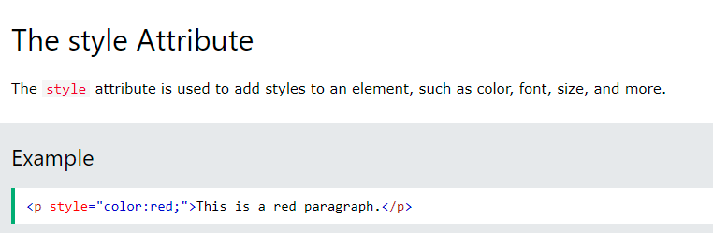
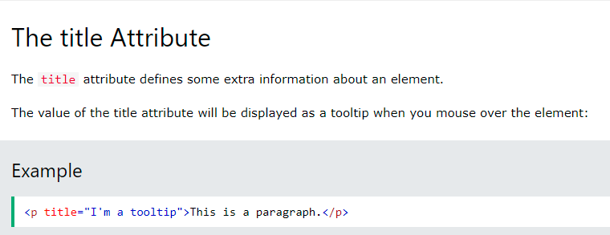

Slide 31
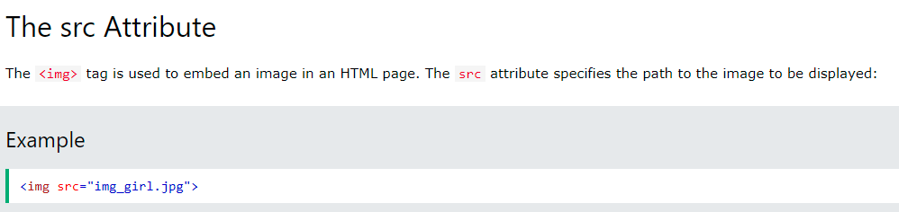
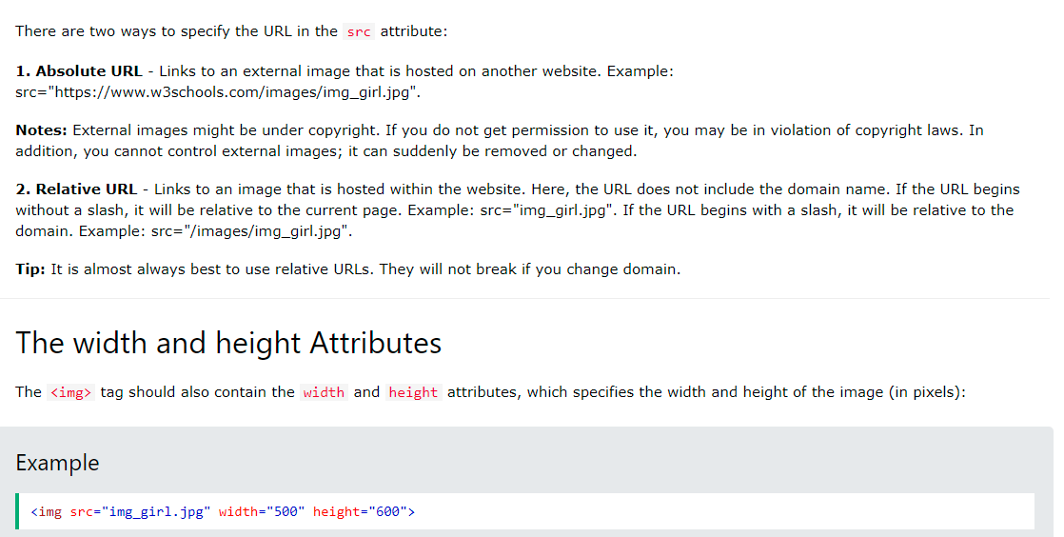

Slide 32
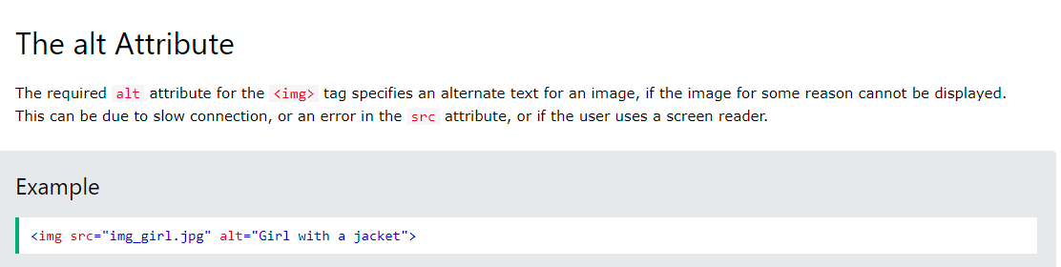

Slide 33
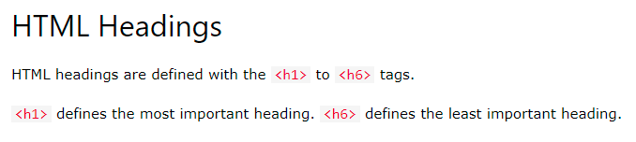
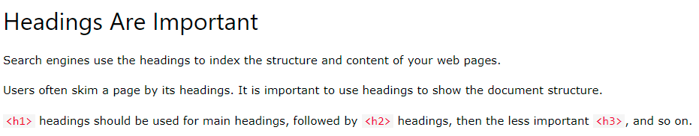
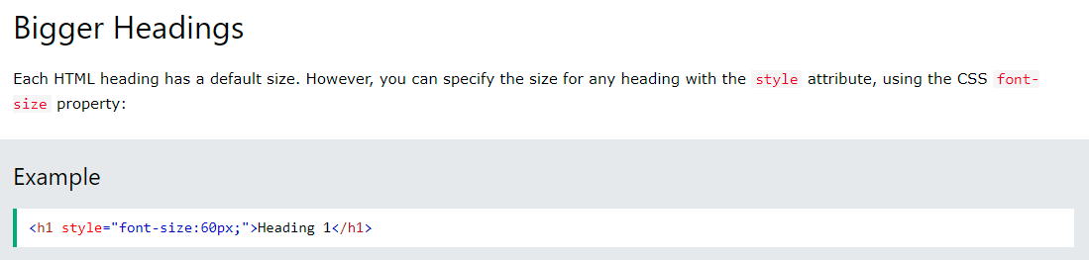

Slide 34
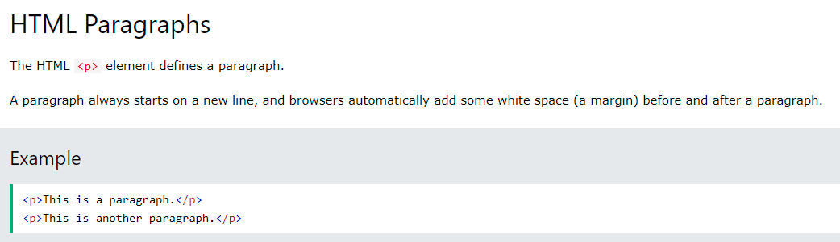
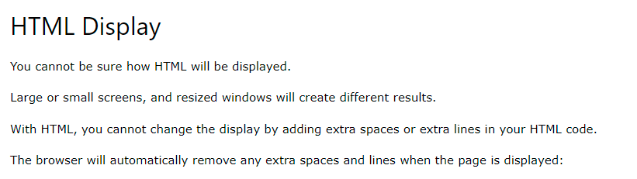

Slide 35
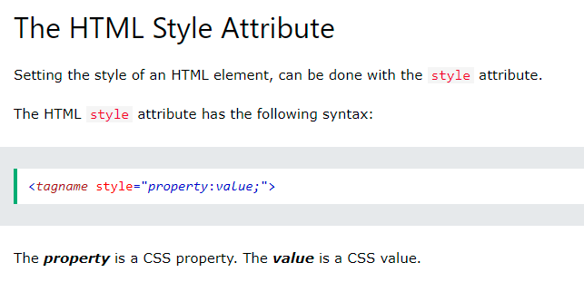
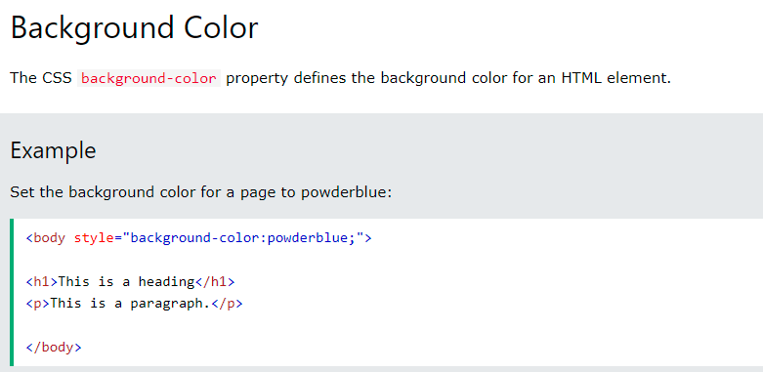

Slide 36
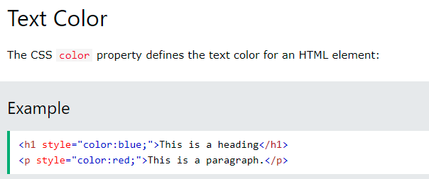
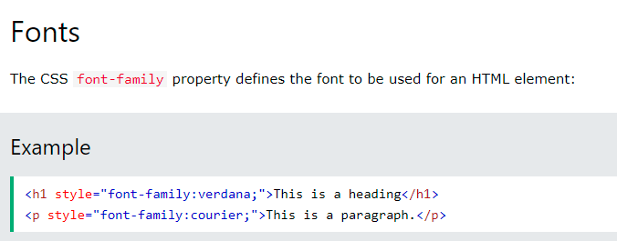

Slide 37
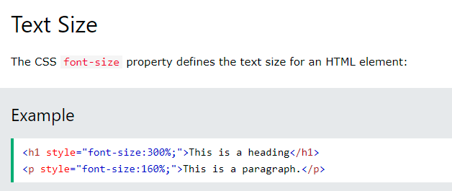
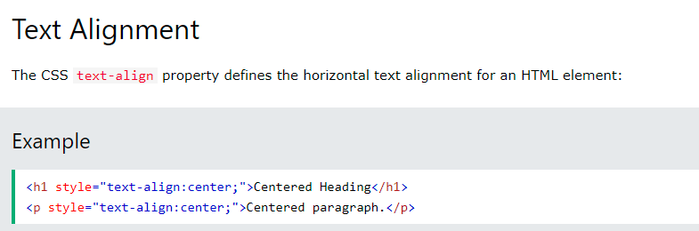

Slide 38

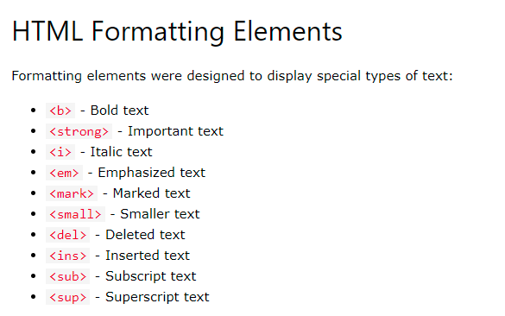

Slide 39
HTML <b> and <strong> Elements
The HTML <b> element defines bold text, without any extra importance.
The HTML <strong> element defines text with strong importance. The content inside is typically displayed in bold.
HTML <i> and <em> Elements
The HTML <i> element defines a part of text in an alternate voice or mood. The content inside is typically displayed in italic.
Tip: The <i> tag is often used to indicate a technical term, a phrase from another language, a thought, a ship name, etc.
The HTML <em> element defines emphasized text. The content inside is typically displayed in italic.
Tip: A screen reader will pronounce the words in <em> with an emphasis, using verbal stress.
HTML <small> Element
The HTML <small> element defines smaller text:
HTML <mark> Element
The HTML <mark> element defines text that should be marked or highlighted:
HTML <del> Element
The HTML <del> element defines text that has been deleted from a document. Browsers will usually strike a line through deleted text:
HTML <ins> Element
The HTML <ins> element defines a text that has been inserted into a document. Browsers will usually underline inserted text:
HTML <sub> Element
The HTML <sub> element defines subscript text. Subscript text appears half a character below the normal line, and is sometimes rendered in a smaller font. Subscript text can be used for chemical formulas, like H₂O:
HTML <sup> Element
The HTML <sup> element defines superscript text. Superscript text appears half a character above the normal line, and is sometimes rendered in a smaller font. Superscript text can be used for footnotes, like WWW^{[1]}:

Slide 40
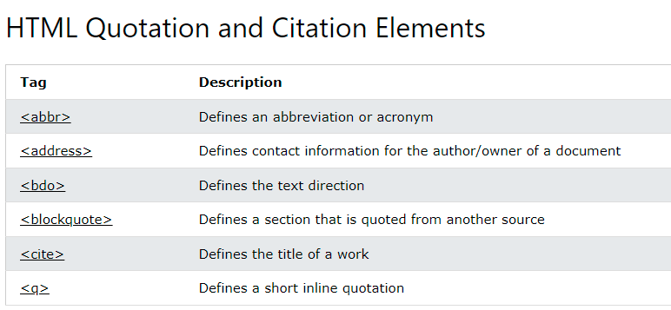

Slide 41
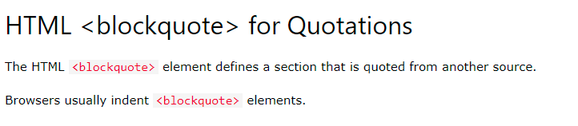
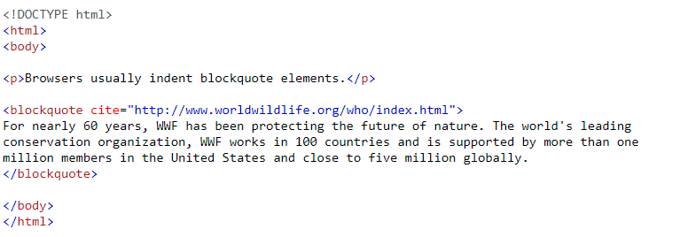
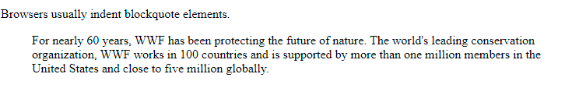

Slide 42




Slide 43




Slide 44




Slide 45


Slide 46



Slide 47


Slide 48


Slide 49


Slide 50


Slide 51


Slide 52





Slide 53




Slide 55


Slide 56



Slide 57



Slide 58



Slide 59




Slide 60



